Slide 1


Green Pace
Security Policy Presentation
Developer: Abby Farnsworth

Slide 2

OVERVIEW: DEFENSE IN DEPTH

Slide 3
THREATS MATRIX
Likely Insecure coding likely to be exploited | Probable Insecure coding will be probably be violated | Unlikely Insecure coding unlikely to be exploited
High priority High severity, likely, inexpensive to repair | Medium Priority Medium severity, probable, medium cost to repair | Low priority Low severity, unlikely, high cost to repair

Slide 4
10 PRINCIPLES
Validate Input Data (Applicable coding standard: STD-004-CPP)
Heed Compiler Warnings (Applicable coding standards: STD-003-CPP, STD-006-CPP)
Architect and Design for Security Policies
4. Keep It Simple (Applicable coding standard: STD-009-CPP)

Slide 5
10 PRINCIPLES CONT.
5. Default Deny
6. Adhere to the Principle of Least Privilege
7. Sanitize Data Sent to Other Systems (Applicable coding standard: STD-004-CPP)

Slide 6
10 PRINCIPLES CONT.
8. Practice Defense in Depth (Applicable coding standards: All)
9. Use Effective Quality Assurance Techniques (Applicable coding standards: All)
10. Adopt a Secure Coding Standard (Applicable coding standards: All)

Slide 7
CODING STANDARDS
STD-003-CPP Do not attempt to create a std::string from a null pointer. Priority High, Level 1.
STD-004-CPP Exclude user input from format strings. Priority High, Level 1.
STD-005-CPP Do not access freed memory. Priority High, Level 1.
STD-007-CPP Detect and handle standard library errors. Priority High, Level 1.
STD-006-CPP Assertion Handling. Priority Medium, Level 2.

Slide 8
CODING STANDARDS CONT.
STD-008-CPP Do not use floating-point variables as loop counters. Priority Medium, Level 2.
STD-009-CPP Do not subtract or compare two pointers that do not refer to the same array. Priority Medium, Level 2
STD-010-CPP Ensure that control never reaches the end of a non-void function. Priority Medium, Level 2.
STD-002-CPP Ensure that unsigned integer operations do not wrap. Priority Medium, Level 2.
STD-001-CPP Use correct integer precisions. Priority Low, Level 3

Slide 9
Priority & Threat Level
L3: P1-P4 Low
L2: P6-P9 Medium
L3: P12-P27 High

Slide 10
ENCRYPTION POLICIES
*Encryption in rest
*Encryption at flight
*Encryption in use

Slide 11
TRIPLE-A POLICIES
Authentication – Who are you?
Authorization – What are you allowed to do?
Accounting – What are you doing?

Slide 12
Unit Testing – Buffer Overflows
Noncompliant code leading to buffer overflow:
#include <algorithm>
#include <vector>
void f(const std::vector<int> &src) {
std::vector<int> dest;
std::copy(src.begin(), src.end(), dest.begin());
// ...
}
(Note: code written by J. Pincar, 2021)

Slide 13
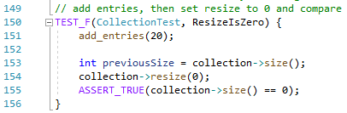
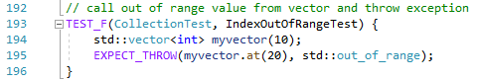
Unit Testing – Buffer Overflows
Positive test
Negative test

Slide 14
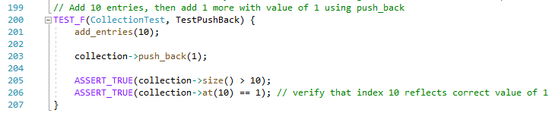
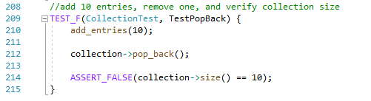
Unit Testing – Buffer Overflows
Assert true
Assert false

Slide 15

AUTOMATION SUMMARY

Slide 16
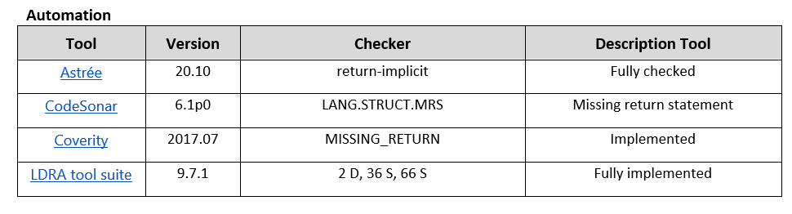
TOOLS
Example of automation tools used for insecure code testing:

Slide 17
RISKS AND BENEFITS
Adopting these security standards
Why act now?
No risk, all reward

Slide 18
RECOMMENDATIONS
Use the SEI CERT C++ Coding Standard document for a thorough guide on C++ secure coding practices.
Keep in mind the SEI Cert is always being updated.
Additional security practices to consider:
Cryptographic practices
Error handling and logging

Slide 19
CONCLUSIONS
Building stronger, more secure software requires the adoption of secure policies and standards.
This policy is here for your guidance and protection.
It is vital that the entire development team follows these standards.

Slide 20
REFERENCES
Harvey, S. (Feb 2020). Secure Coding Best Practices. Retrieved from https://kirkpatrickprice.com/blog/secure-coding-best-practices/
Pincar, J. (2021). CTR52-CPP. Guarantee that library functions do not overflow. Retrieved from https://wiki.sei.cmu.edu/confluence/display/cplusplus/CTR52-CPP.+Guarantee+that+library+functions+do+not+overflow
SEI CERT C++ Coding Standard. (2020). Retrieved from https://wiki.sei.cmu.edu/confluence/pages/viewpage.action?pageId=88046682

